Slide 1
Working in an Agile team
Agile Fundamentals

Slide 2

Agile is an umbrella term
Scrum
Dynamic Systems Development Method – DSDM
Test Driven Development – TDD
Extreme Programming – XP
Lean
Kanban
SAFe
and more…
Notes:
An umbrella term covering development frameworks that adhere to the Agile manifesto.

Slide 3

The essence of Agile
Embrace change
Iterative
Empirical
Incremental
Self organising teams
Empowered
Fail fast
Feedback
and more…

Slide 4
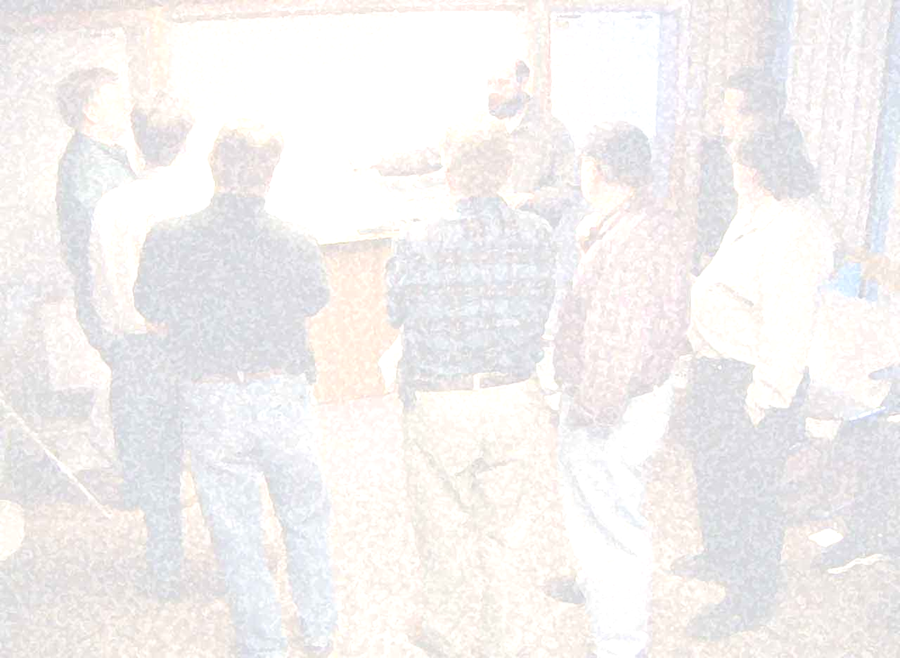
Agile Manifesto - 2001
We are uncovering better ways of developing software by doing it and helping others do it.
Through this work we have come to value:
Individuals and interactions over processes and tools
Working software over comprehensive documentation
Customer collaboration over contract negotiation
Responding to change over following a plan
That is, while there is value in the items on the right, we value the items on the left more
http://agilemanifesto.org/

Slide 5
12 Agile principles
Welcome changing requirements, even late in development.
Agile processes harness change for the customer's competitive advantage.
Deliver working software frequently, from a couple of weeks to a couple of months, with a preference to the shorter timescale.
Our highest priority is to satisfy the customer through early and continuous delivery of valuable software.
1
2
3
4
5
6
Business people and developers must work together daily throughout the project.
Build projects around motivated individuals. Give them the environment and support they need, and trust them to get the job done.
The most efficient and effective method of conveying information to and within a development
team is face-to-face conversation.

Slide 6
12 Agile principles
Agile processes promote sustainable development. The sponsors, developers, and users should be able to maintain a constant pace indefinitely.
Continuous attention to technical excellence and good design enhances agility.
Working software is the primary measure of progress.
7
8
9
10
11
12
Simplicity – the art of maximising the amount of work not done – is essential.
The best architectures, requirements, and designs emerge from self-organising teams.
At regular intervals, the team reflects on how to become more effective, then tunes and adjusts its behaviour accordingly.

Slide 7
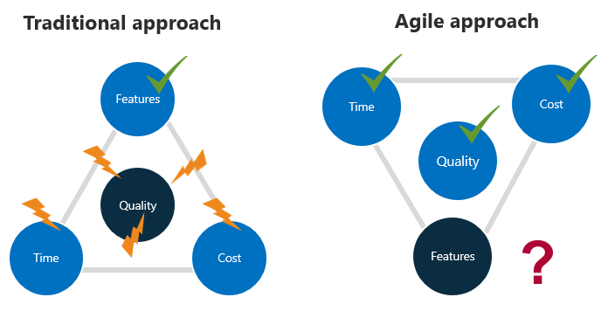
Project management forces
Notes:
Green checks are fixed in the approach
Other values are variable

Slide 8
Working in an Agile team
The Scrum Framework

Slide 9
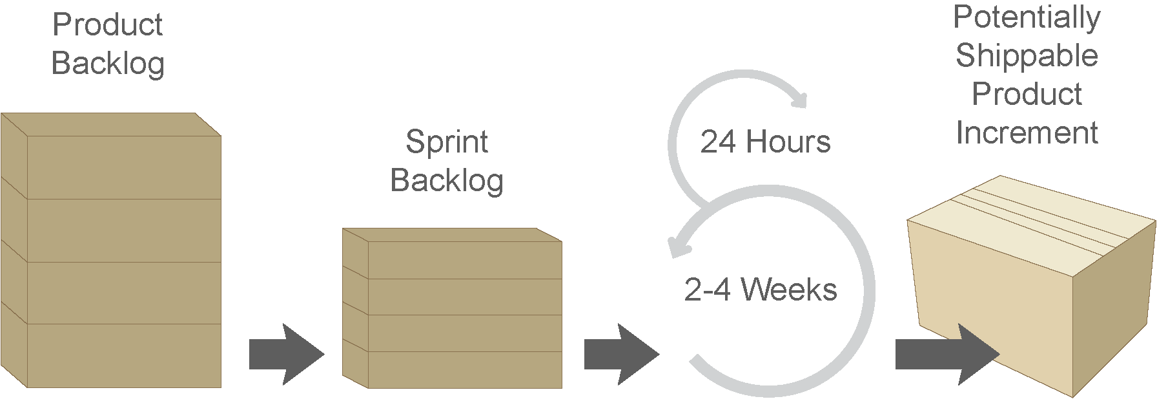
Scrum framework

Slide 10
Scrum elements
Events
Sprint
Sprint planning meeting
Sprint review meeting
Sprint retrospective
Daily Scrum
Roles
Scrum master
Product owner
Developer
Artifacts
Product backlog
Sprint backlog
Increment
Values
Courage
Focus
Commitment
Respect
Openness

Slide 11
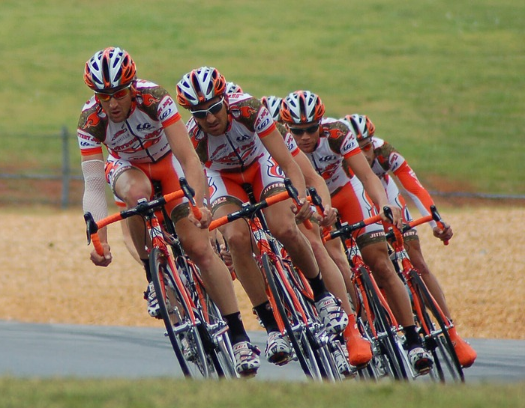
Event – The Sprint
A time-boxed period of software development
Container for all other events
One-week to one-month duration
Always produces a potentially shippable Product Increment
Facilitates empirical process control
Team work on the set of User Stories and Tasks defined in the Sprint planning meeting
Notes:
Always plan one sprint at a time
Scrum master facilitates
Scrum master manages impediments
Team work without interruption
No new additions to Sprint Backlog are allowed

Slide 12
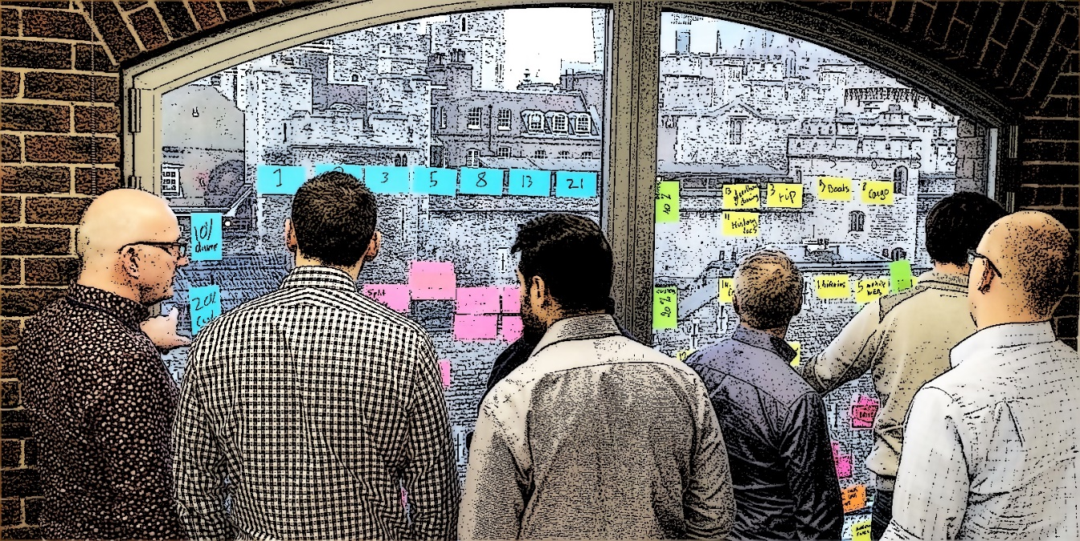
Event – Sprint planning meeting
For the Scrum Team to plan the Sprint delivery
Timeboxed to eight hours for one-month Sprint
Split into two four-hour parts; What and How
PO presents the top priority backlog items
All work together to decide on what functionality is to be developed during the next sprint
Attendees:
Product Owner
Scrum Master
Development Team
Notes:
Who attends:
Product Owner
Scrum Master
Development Team
Inputs:
Product Backlog, latest increment of product, capacity and velocity of team
Outputs:
Sprint backlog
Sprint goal
Development Team design system and work TBD
Work decomposed to <1day tasks
Product Owner clarifies/makes trade-offs
Development Team explain how they will meet Sprint goal

Slide 13

Event – Sprint review meeting
Informal event held at end of every Sprint
Assess progress against the sprint goal
For everyone involved including customers, management and stakeholders
Inspect what was produced in the last sprint and to give acceptance and/or feedback
Four-hour timebox for a one-month Sprint
Attendees:
Scrum Team
Stakeholders invited by Product Owner
Output: revised Product Backlog
https://commons.wikimedia.org/wiki/File:Science_Fair_(32783162264).jpg
Notes:
Source: Coast Guard - https://commons.wikimedia.org/wiki/File:Science_Fair_(32783162264).jpg
Show how team have delivered against its forecast
Review/demonstrate functionality that has been completed
Review progress

Slide 14

Event – Sprint retrospective meeting
Facilitated by the Scrum Master to discuss:
What went right
What went wrong
What would we change
Actions to be assigned
Can include discussion on processes, practices, communication, environment, tools, etc.
Everyone should get the chance to air their views
Open
Honest
Constructive
Notes:
The sprint retrospective meeting is an integral part of the inspect and adapt process
The ScrumMaster must pay attention to this meeting and work towards resolving the impediments that may be slowing down the team
ScrumMaster and Team discuss the just concluded Sprint and determine what could be changed that might make the next Sprint more enjoyable and productive
The Sprint Review looks at 'What' the team are building whereas the Retrospective looks at 'How' they are building
Held at the end of every sprint after the sprint review meeting
The team and ScrumMaster meet to discuss what went well and what to improve in the next sprint
Time-boxed to three hours
Product Owner should be allowed to have their say if they wish to but this is not mandatory
Use to improve processes
Collaborative between all members of Team, PO and SM
All team members allowed to air views
Scrum Master is facilitator who prioritises actions and lessons learned
Team devises solutions to any problems
Helps with team forming and bonding and removing conflict

Slide 15
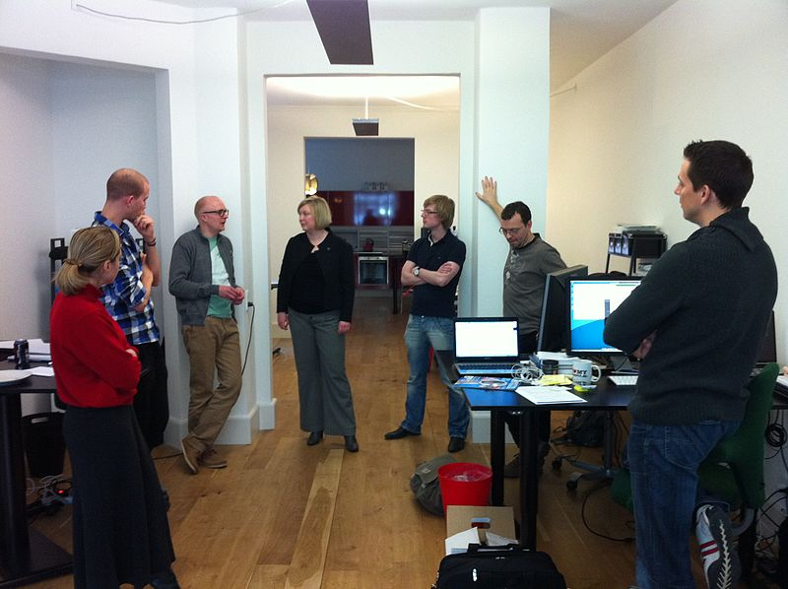
Event – Daily Scrum
Daily inspect and adapt event for the Development Team
Scrum Master ensures Daily Scrum occurs
Same time, same place
<15 minutes
Often called a 'stand-up‘
Three questions to be asked and answered:
What did I do yesterday?
What am I planning to do today?
What impediments are stopping me completing my tasks?
https://commons.wikimedia.org/wiki/File:Daily_sprint_meeting.jpg
Notes:
Image source: Klean Denmark, https://commons.wikimedia.org/wiki/File:Daily_sprint_meeting.jpg
Why:
To enable communication and collaboration between team members
To give focus and ensure sprint is still on track
Used as the smallest tightest feedback loop
To enable understanding of impediments or problems that may arise and that are hindering current sprint
Facilitates actions for discussion later
Shows ability for self-organisation and task sharing
Ability to identify quickly any issues arising
Only one person at a time speaks – others wait until they have finished
All team members must attend in person or if unavoidable, by phone – on rare occasions they can update another member of the team to speak for them

Slide 16
Scrum Artefacts
Product backlog
Single source of requirements
Sprint backlog
Items that need to be done in the sprint
Increment
Sum of the PBI completed in a sprint

Slide 17
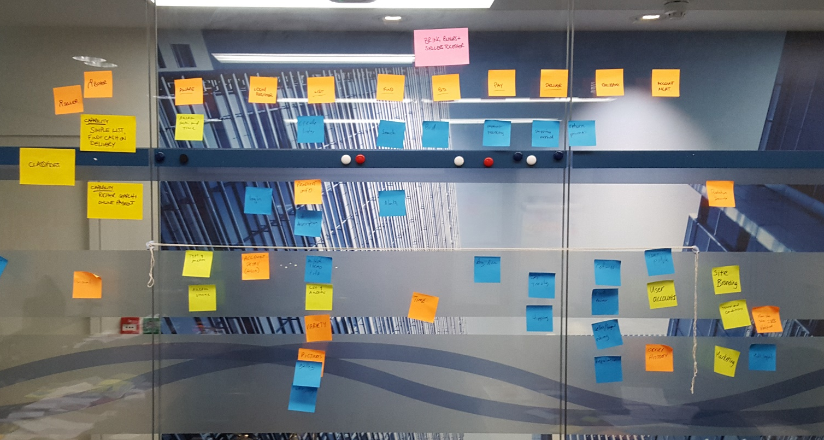
Artefacts – Product backlog
Ordered list of everything that might be needed in the product
Single source of requirements
Owned by PO
Refined by Scrum Team
Developed by Development Team
Can be on cards or held on computer, but visible to all
Understandable to all stakeholders
DEEP
Notes:
Product Backlog – DEEP
Detailed appropriately
Higher priority items described in more detail, smaller and more concise, lower priority items have less detail as they can be detailed later in the release. This keeps the backlog concise, as a consequence requirements are discovered throughout the project
Product discovery is ongoing
Estimated
The product backlog items are roughly estimated in story points or days – leave detailed planning to the Sprint planning meeting
Emergent
The product backlog evolves throughout the project, the content changes with user feedback, and as the product is developed new areas can be uncovered – it is dynamic
Prioritised
All items are prioritised, the most important are implemented first
Useful factors for prioritising are:
Value, knowledge, uncertainty, risk, releasability and dependencies
Priorities direct the team's work
Product Backlog Items – PBIs can take many forms:
User Stories
Use Cases
Bugs
Constraints
Etc.

Slide 18
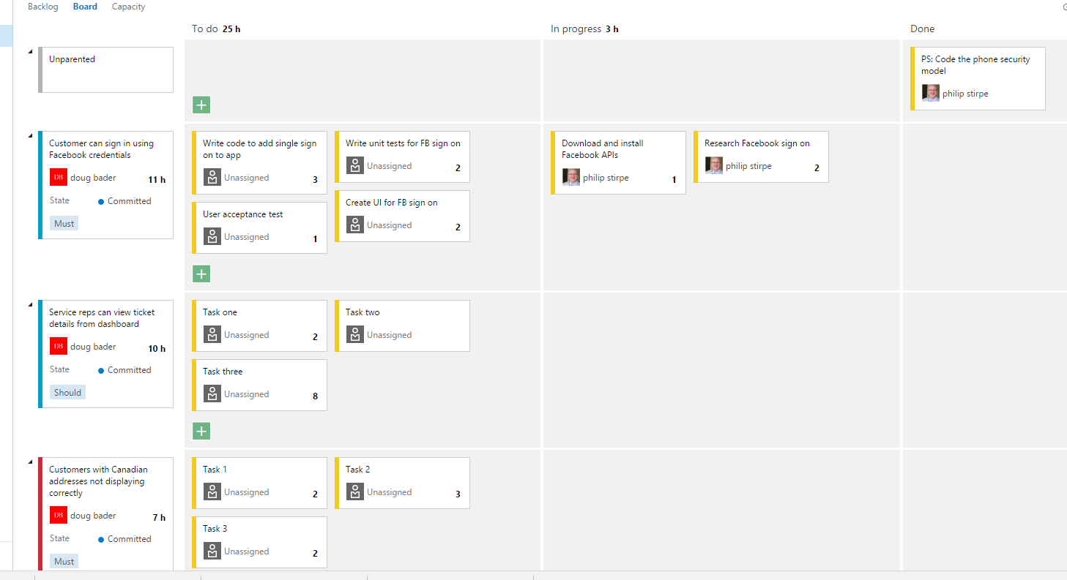
Artefacts – Sprint backlog
List of tasks committed to complete in the current Sprint or iteration
Team decides on the items and time required to complete them
User stories are broken down into tasks
Any team member can pick from tasks
Property of the team
Shown on the task board for all to see
Notes:
List of tasks committed to complete in the current Sprint or iteration
Items taken from Product Backlog based on priorities set by the Product Owner
Team decides on the items and time required to complete them
User stories are broken down into tasks
Try to break down tasks into about one day's work
Smaller tasks allows a level of detail that the whole team understands the extent of work to do
Any team member can pick from tasks
This promotes self-organisation
Property of the team
Shown on the task board for all to see
Nine tips for creating a good Sprint Backlog – Scrum Alliance 24-03-09
Involve every team member in process
Discuss how every item should be implemented
Have a definition of done
Identify all kinds of tasks
Don't estimate tasks at all
Don't assign tasks up front
Review Sprint commitment
Don't use too much time
Evolve the Sprint Backlog during the Sprint

Slide 19

Artefact - Increment
"Sum of all the Product Backlog items completed during a Sprint and the value of the increments of all previous Sprints“ - Scrum Guide
Must meet Scrum Team's Definition of Done

Slide 20
Scrum roles
Scrum master
The facilitator of scrum
Product owner
The person accountable for the product
Developer
The person(s) responsible for creating the product

Slide 21
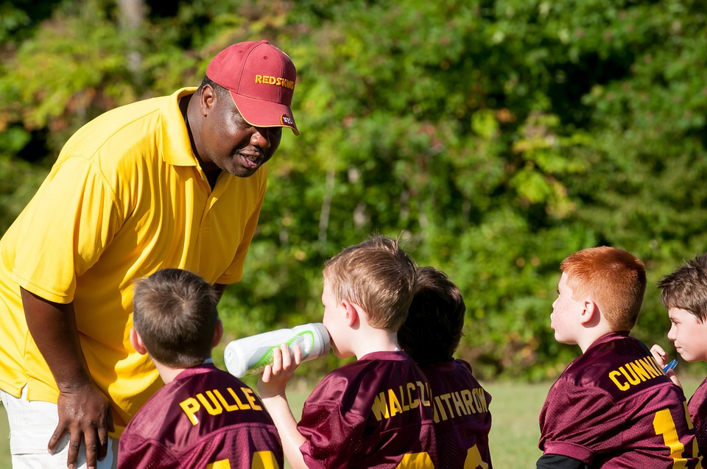
Role – Scrum master
Ensures the Scrum process is followed and understood
Removes impediments to enable the Development team to be fully functional and productive
No formal authority over Development team
Notes:
Attributes
Responsible
Humble
Collaborative
Committed
Influential
Knowledge

Slide 22

Role – Product owner
Owns the Product Backlog
Defines the Product Backlog items
Responsible for profitability – ROI
Prioritises/orders Backlog items
Provides vision and boundaries
Single authority for product
Voice of the customer
The Product Owner is responsible for maximizing the value of the product and the work of the Development Team. – The Scrum Guide
Notes:
"The Product Owner is the one and only person responsible for managing the Product Backlog and ensuring the value of the work the team performs. This person maintains the Product Backlog and ensures it is visible to all.” - Ken Schwaber, 2009
Attributes
Visionary
Leader
Team player
Communicator
Committed

Slide 23

Role – Developer (Development team)
The Development Team consists of developers with all the skills to turn the Product Owner's requirements into a potentially releasable slice of the product by the end of the Sprint
Cross-functional – 3 to 9 people
Self-empowering
Organises itself and its work
Dedicated
Committed
Programmer, tester, DBA, Designer, Architect, etc.
Notes:
'Developers' includes:
Testers
Programmers
QA
Designers
Business Analysts
Etc.
Core team members must be full time.
Co-locate whenever possible.
Communicate face to face as much as possible.
May have specialised skills but willing to learn and share.
Fewer than 3 in a team can lead to constraints and less interaction.
Greater than 9 can lead to complexity in organisation.
Testers are part of the cross-functional Development Team:
Interfacing with development and PO to make sure stories are understood and acceptance tests track desired functionality
Writing the acceptance test code while code is written (with PO, analysts and Development Team)
Testing the code against acceptance tests
Checking in test cases everyday
Develop ongoing test automation to integrate acceptance and feature tests into continuous testing environment

Slide 24
Scrum values
Value | Meaning
Courage | Committing yourself to the team and Sprint Goal.
Focus | Being focused on the sprint and its goal.
Commitment | Committing yourself to the team and Sprint Goal.
Respect | Helping people to learn the things that you are good at and not judging the things that others aren’t good at.
Openness | Highlighting when you have challenges and problems that are stopping you from success.

Slide 25
End of section
The New New Product Development Game
Scrum definition
Scrum framework
Scrum elements
Scrum events
Scrum artefacts
Scrum roles
Scrum values
Notes:
What we have already covered

Slide 26
Working in an Agile team
Understanding Scrum

Slide 27
Understanding Scrum
Working software
Monitoring progress
Velocity
Burndown charts
Scrum events
The Sprint goal
Definition of Done - DoD
Scrum roles

Slide 28



Working software
Working software encourages feedback – when users can see and touch the product they can immediately tell if it is what they want.
Working software helps a team gauge its progress – work shown to be complete allows for real progress to be identified.
Working software allows product to be shipped early if desired – the option to ship early can be very valuable to your customers to allow for markets that change rapidly.

Slide 29
Monitoring progress
Measurement is for the Development team
Determine progress in the Sprint
Indicator of team performance
Many techniques:
Burndown charts
Kanban boards
Etc.

Slide 30

Velocity
Velocity = amount of work the team is able to get done in one Sprint
Based on experience from previous sprints (estimated for first few sprints)
Can be measured in:
Ideal days
Story points
Helps improve estimation over length of project
Notes:
In the first one or two sprints you will have to estimate your teams velocity as you do not have any empirical data to rely on – Boehm’s Cone
This can be a hard concept to get your head around initially, this is why we have the concept of velocity. As time goes on its becomes easier to manage. If you are finding it difficult to estimate a time for a story it may be that the story is too complex
After two or three sprints you should be able to start using the data gathered from the previous iterations
For example, if you have delivered 19, 17 and 21 story points in your last three sprints then your range is 17-21 story points per sprint
If, however, you have been able to deliver 21 story points of similar size and complexity in each sprint then 21 is a good measure to use
Do NOT compare velocity between teams

Slide 31
Velocity is NOT capability
How many story points the team can get done in one Sprint
Velocity
Team size
Sprint length
Absence
Capacity
Know-how
Impediments
Capability
Notes:
Do not allow a low velocity to become an issue.

Slide 32
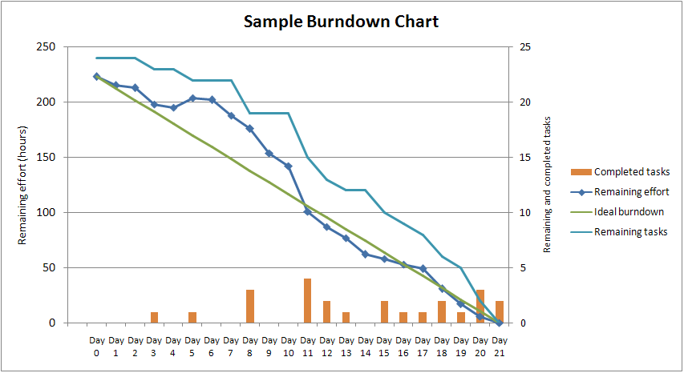
Burndown Chart
Daily feedback chart visible for all to see
Information radiator
Measured in Story points

Slide 33
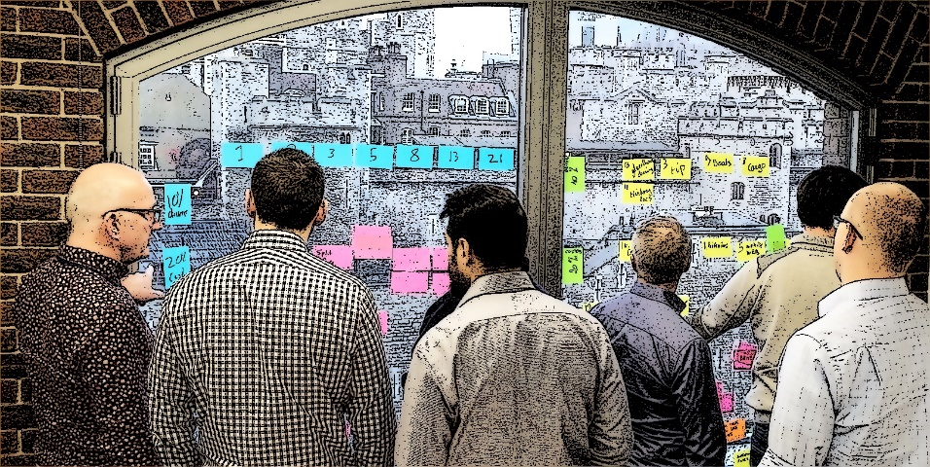
Sprint planning meeting
Inputs
Product backlog
Team velocity and capacity
Definition of done - DoD
Definition of ready - DoR
Retrospective commitments
Outputs
Sprint goal
Sprint backlog
Forecast
Notes:
DoD = When a product backlog item or increment is seen as ‘Done’ Everyone must understand what ‘Done’ means. This is accomplished using a checklist of some sort.
DoR = essentially a story is “Ready” when the team can agree that they can get it “Done”

Slide 34

Sprint goal
An objective to be met through implementing the product backlog
Guidance for the Team
Subset of release goal
Not set in stone – wriggle room
Can be re-assessed at end of sprint
Example:
“Deliver basic Shopping Cart functionality”

Slide 35

Definition of done
Checklist of activities to be completed for Product Backlog Item or Product Increment to be 'done'
Defined in advance
Transparent to all
Agreed by Scrum Team
Evolves
The definition of which must be understood by everyone in the Scrum Team

Slide 36
Product Backlog Items - PBIs
Can take many forms:
User Stories
Use Cases
Bugs
Constraints
Etc.

Slide 37

User stories
Customer can view film listings
Initial requirement
As a customer,
I want to view film listings,
So that I can choose which movie I would like to watch
Expressed as a User Story

Slide 38
Working in an Agile team
Planning and estimating

Slide 39
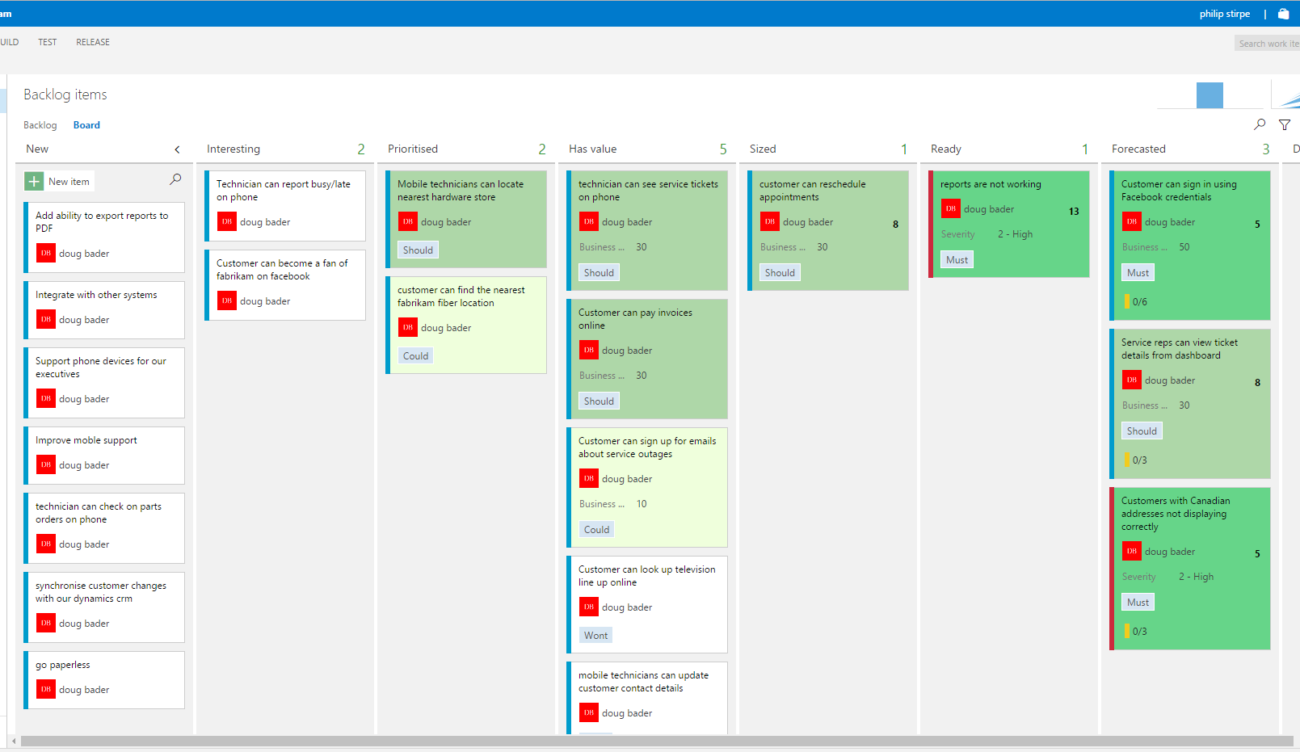
Product backlog refinement
Adding detail, estimates, and order to items in the Product Backlog
Usually consumes no more than 10% of the capacity of the Development Team
Development Team refine the PBIs with the Product Owner
Dev team estimate the “size” of each PBI
Perhaps using Story Points
Team may create a Definition of Ready - DoR

Slide 40
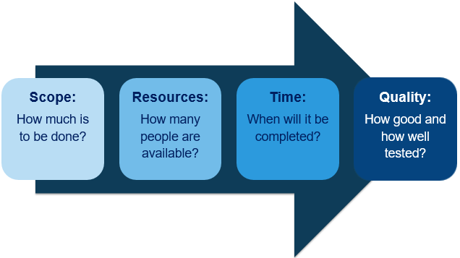
Release planning meeting
Many teams – pre-project – will hold a Release Planning Meeting, although this is technically not part of the Scrum Framework
Four variables:
Scope
Resources
Time
Quality
Notes:
Who attends:
Product Owner
Customer
Scrum Master
Experienced Developers and Testers
Any other interested parties, i.e.,
Architects
Client business team

Slide 41

Estimating
Reducing/highlighting risk
Reducing uncertainty
Supporting better decision making
Establishing trust
Conveying information
It is not committing

Slide 42
Estimation techniques
S M L
Assign points independently then discuss and assign again, and again...
0,1,2,3,5,8,13,21
T-shirt
Each member has a set of cards with points and declares his/her hand
Delphi
Rock Paper Scissors
Scale
Poker cards
RPS

Slide 43
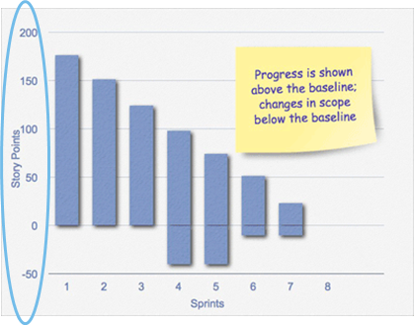
Estimating with Story Points
Story points are a unit of measure for expressing the overall size of a user story, feature or other piece of work
We assign a point value to each item
The raw values are unimportant – it is the relative values that are important
E.g. a story that is 20 points must be four times the effort of one that is 5 points and half the size of one that is 40 points

Slide 44
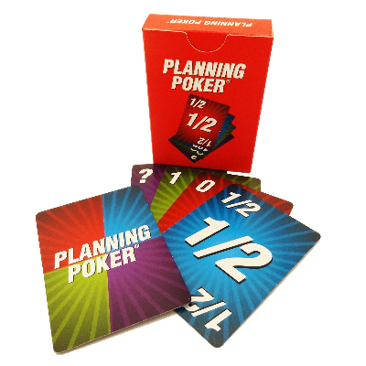
Planning poker
The Scrum Master will usually facilitate the Planning Game
It is useful for the Product Owner and possibly the lead architect to attend
Address questions that will arise about the intent or implementation of the stories/tasks
A good way to start pointing is to look at a medium story/task that is easily measured, assign it a number of points (e.g., five) and then base all others as: "Is this story like the first one?" Is it larger, smaller, more complex? etc.
Notes:
The ScrumMaster will usually facilitate the Planning Game
It is useful for the Product Owner and possibly the lead architect (if there is one) to attend to address questions that will arise about the intent or implementation of the stories/tasks
A good way to start pointing is to look at a medium story/task that is easily measured, assign it a number of points (e.g., five) and then base all others as: "Is this story like the first one?" Is it larger, smaller, more complex? etc.

Slide 45
Planning Poker – Example Steps
Give each estimator a set of cards containing numbers to be used (e.g. 1 to 10)
Product owner reads out one of the user story and further contextualises it if needs be
All the estimators select a card based on the difficulty of the story
Cards are turned over, and discussions can take place
Focus on the outliers – e.g. if 2 people picked 5 and 6 and someone else picked 10, why?
After discussion, re-estimate and discuss again if necessary until estimates converge (it’s not a vote!)

Slide 46
Folding in Planning Poker
Depending on the estimates, players can fold if their argument has been heard but there’s just disagreement
If there’s still a massive outlier – e.g. 3 people have a 5 and someone else has a 20 – we need to consider why this is the case
Product uncertainty – do they understand what the feature is?
Technical uncertainty – do they understand how to implement the feature?
Solves for this:
Come back to the story later after further discussions
Use a range as the estimate rather than a single number

Slide 47
Thank you
QA hopes you enjoyed your course,
as much as we enjoyed teaching you.

